Slide 1

Analytical Results
Storm Troopers
April 30th, 2026

Slide 2



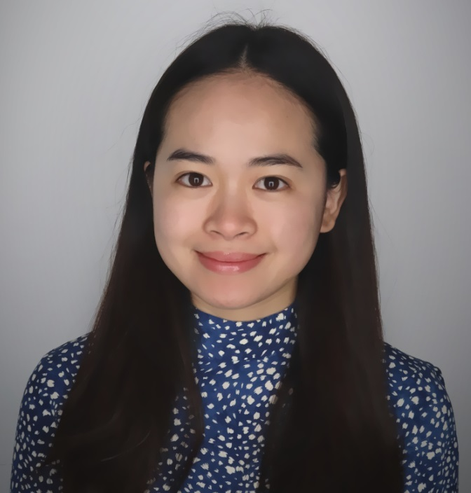
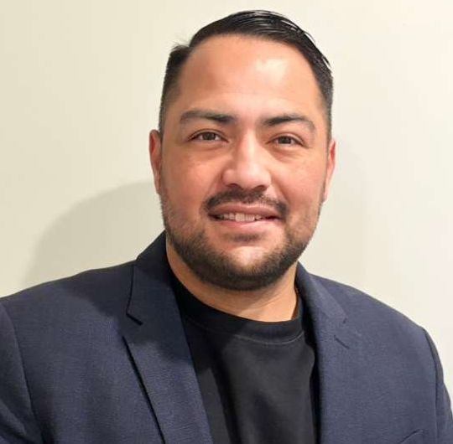
Storm Troopers
Amanda Giddings
Simon Ravula
An Truong
Daniel Juarez

Slide 3
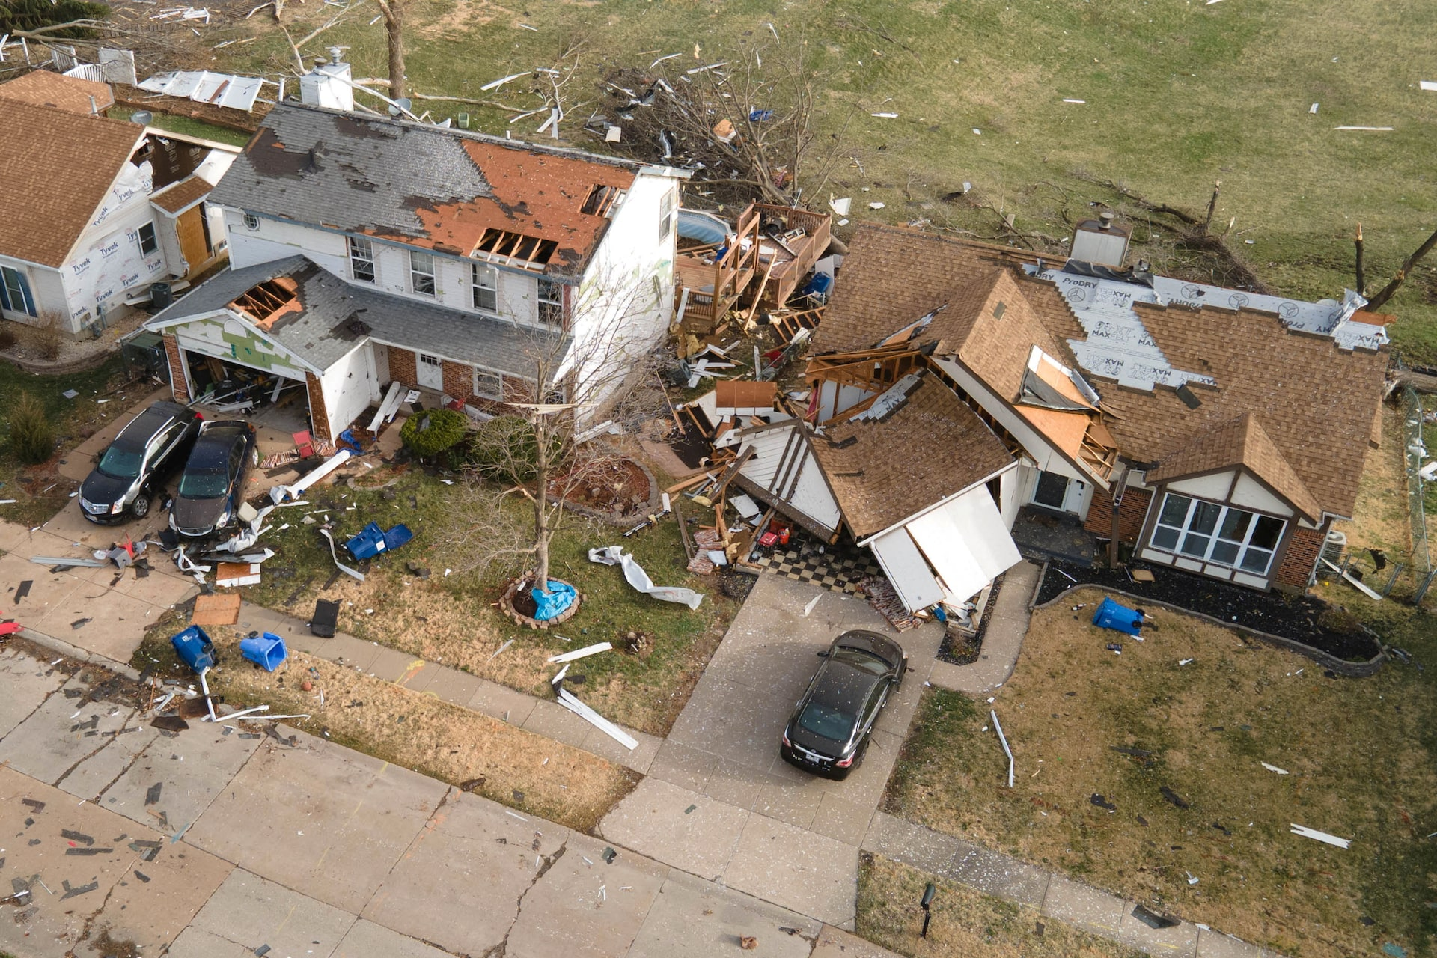
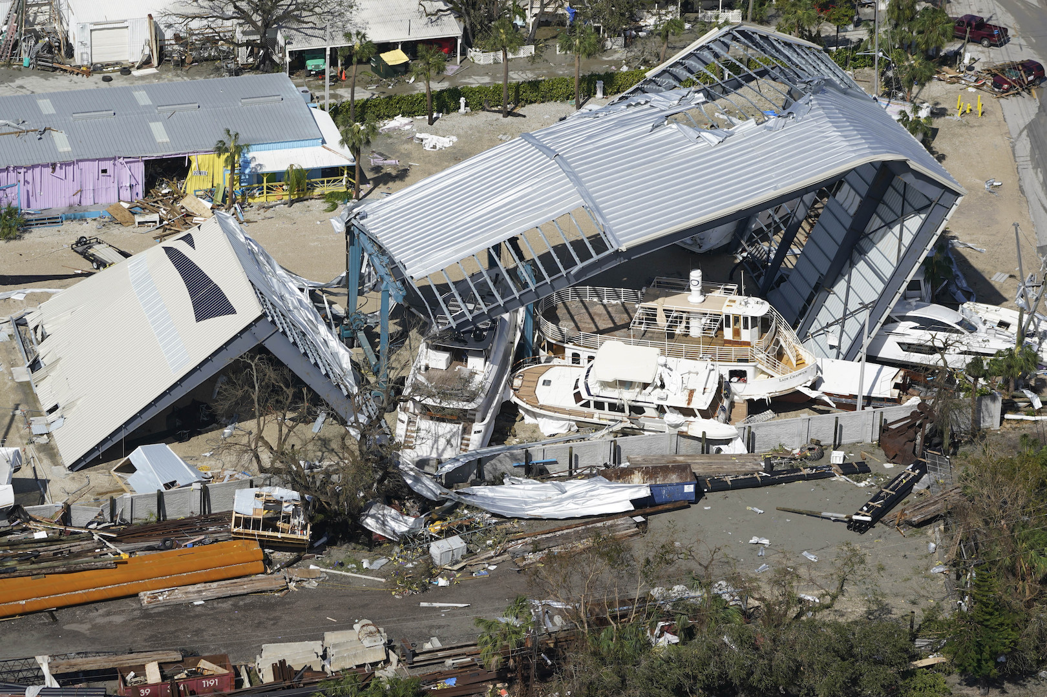
Current Challenge
Adjusters
Claims
Clients
Notes:
Flip the order of green – positive scenario before the red
(Make sure to highlight the differences in Travelers vs their competitors. Tie back to costs (customer loss, revenue loss vs customer retainment) – 2 minutes)

Slide 4
Executive Summary
Problem
Adjuster Shortages
Claim Influx
Approach
Optimized adjuster-claim solution
Result
6-day Delay Time Reduction
100% in Assignment Efficiency
Impact
Cost Savings
Traveler’s SLA Compliance
Customer Satisfaction
Notes:
*satisfaction unless we can quantify financially
Bullet points: optimally match → Results: etc….
Analytical approach: linear programming??
Executive Summary – Problem / Approach / Result / Reccommendation
Business Problem: skilled adjusters and claim influx
Approach: optimized adjuster-claim solution
Result:
reduce delay time by 6 days
Impact:
Cost Savings,
Regulation Compliance,
Customer Retention
Since our team needed to optimize matching our adjusters to equal level claim assignments, we created a model that matched them by proximity and reduced overall delay time by 6 days. For Travelers, this can lead to cost savings, regulation compliance, and customer retention.
To streamline the process of matching adjusters to their claim assignments, we created a model that matched the two based on proximity that reduced delay time by 6 days. This could lead to cost savings, regulation compliance, and customer retention.

Slide 5
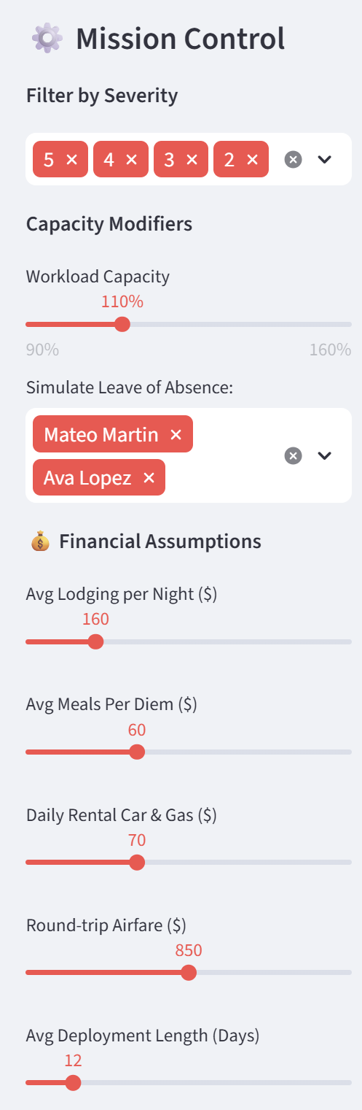
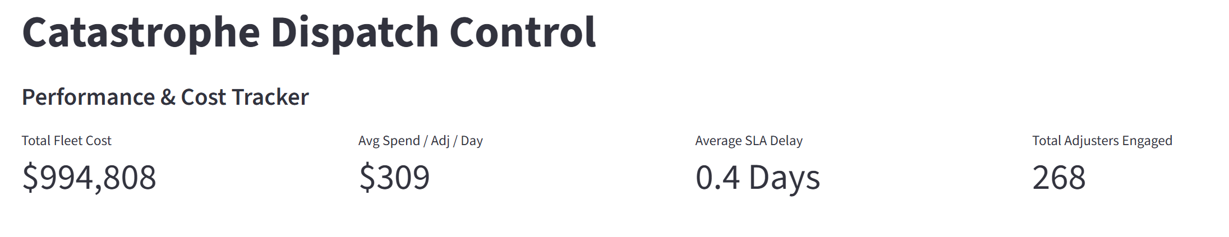
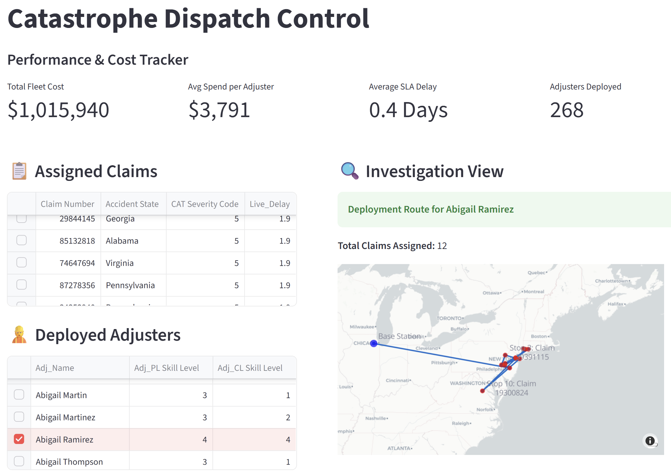
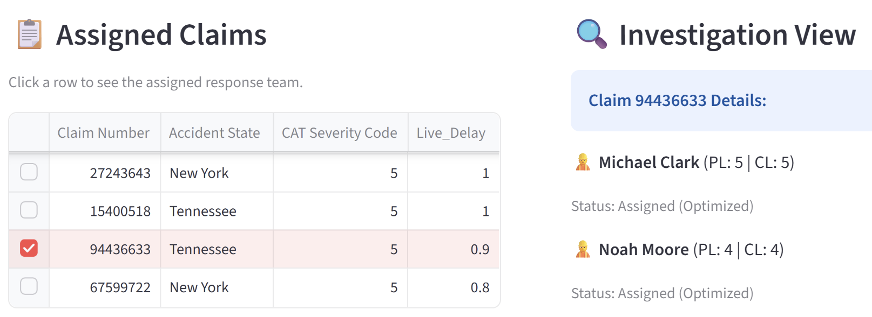

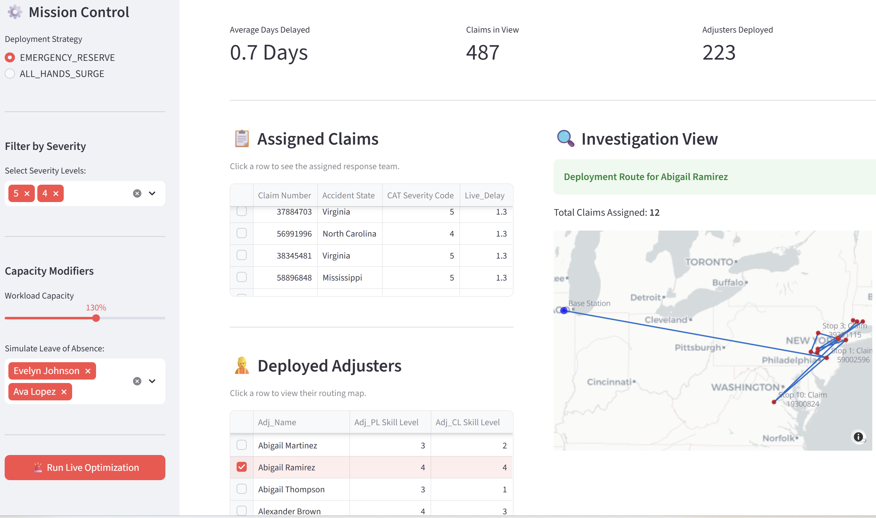
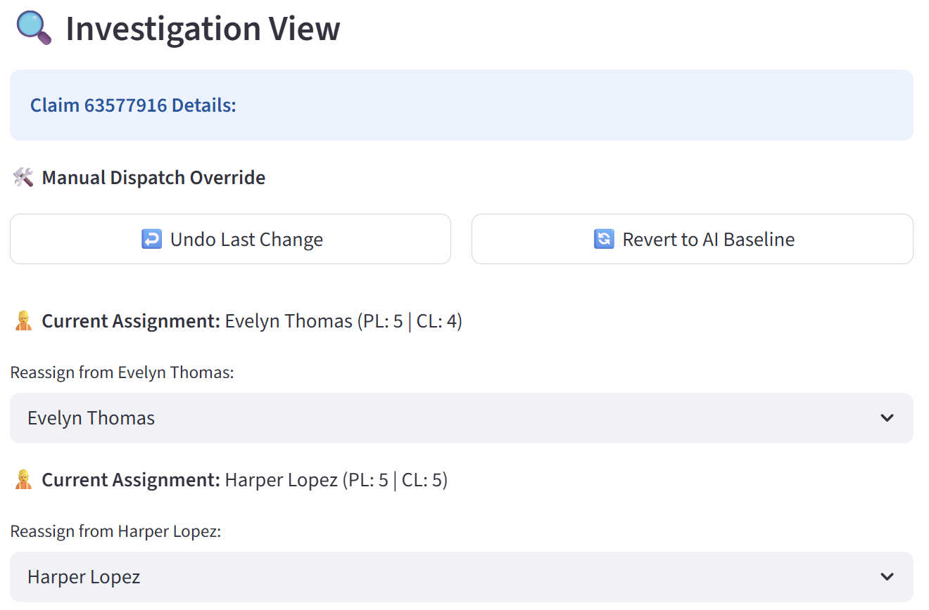
Application
Storm Trooper Manager
Notes:
Pop one section of web app at a time: explain each section of how the solution works. One Red animation at a time.
Have a story: create a persona who use this and how.
Explain the solution before showing the solution: dashboard operational view with metrics feeding; adjustment to features.

Slide 6
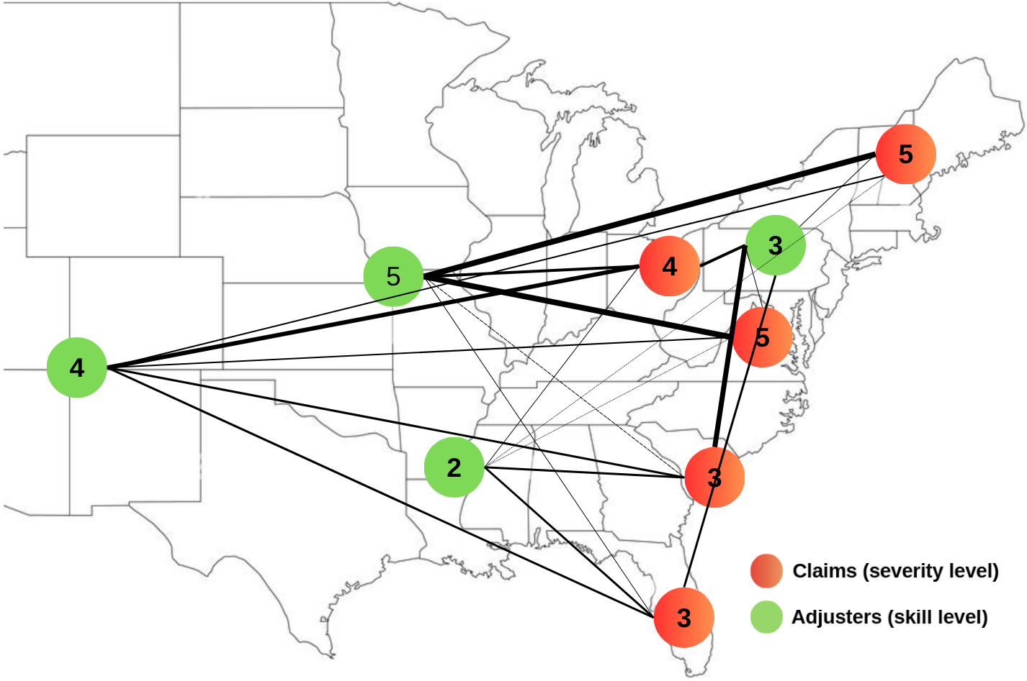
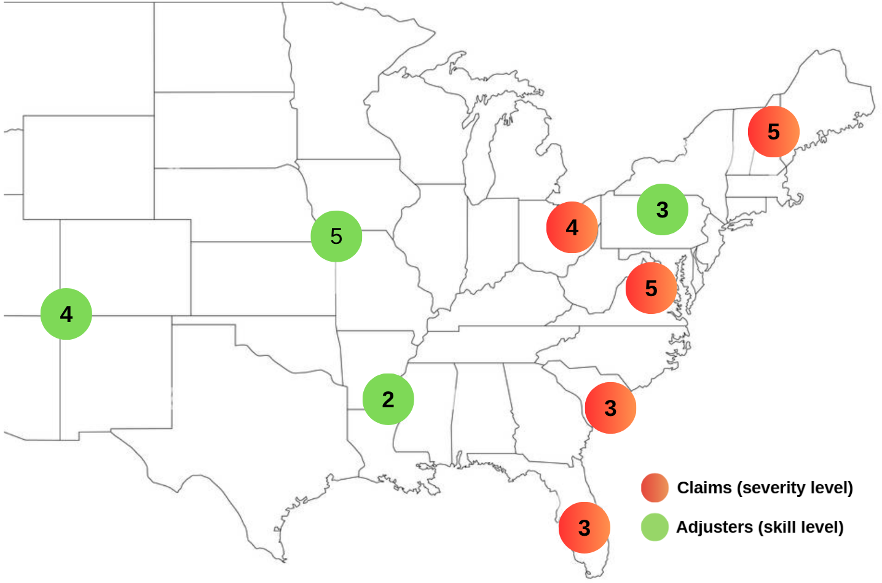
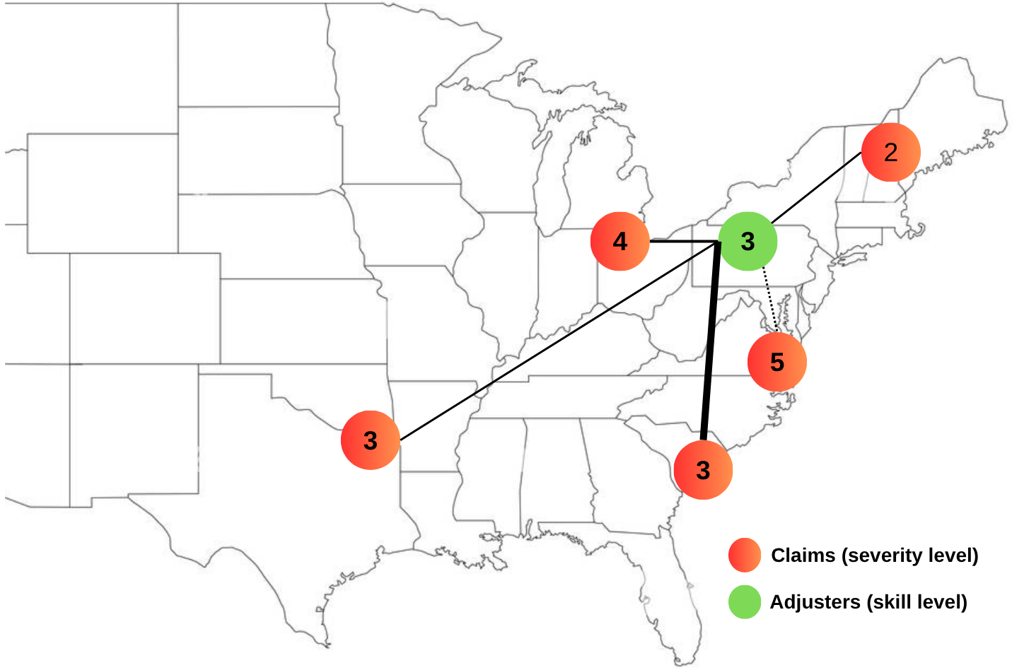
What powers the solution?
The Purpose: Assigning the right adjusters to the right claims at the right time
The Impact: Minimize waste of resources, save on cost and time
🎯 Severity – Skill Matching
⚙️ Adjuster Preferences
⏱️ NOL/SLA Priorities
📍 Adjuster – Claim Distance
LINEAR PROGRAMMING RULES:
Notes:
Assumption title changes to Model Drivers or something else
Think of how to use all spaces, including legends
Another story-telling: make a question to start the slide, give example of each situation – high probability of matching and low probability of matching.
Explain what linear programming does in simple term.

Slide 7
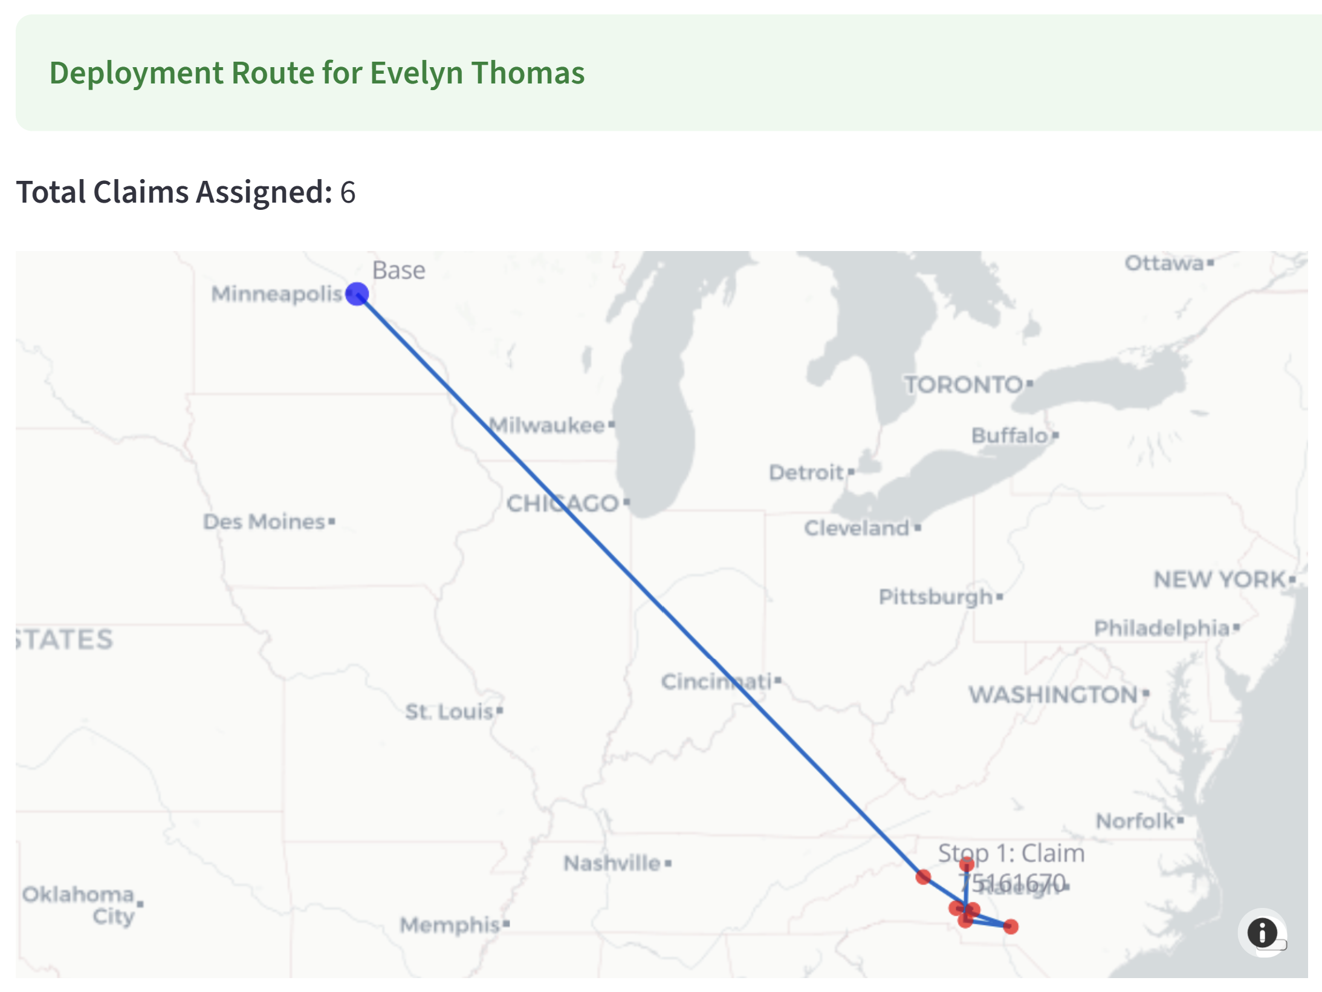
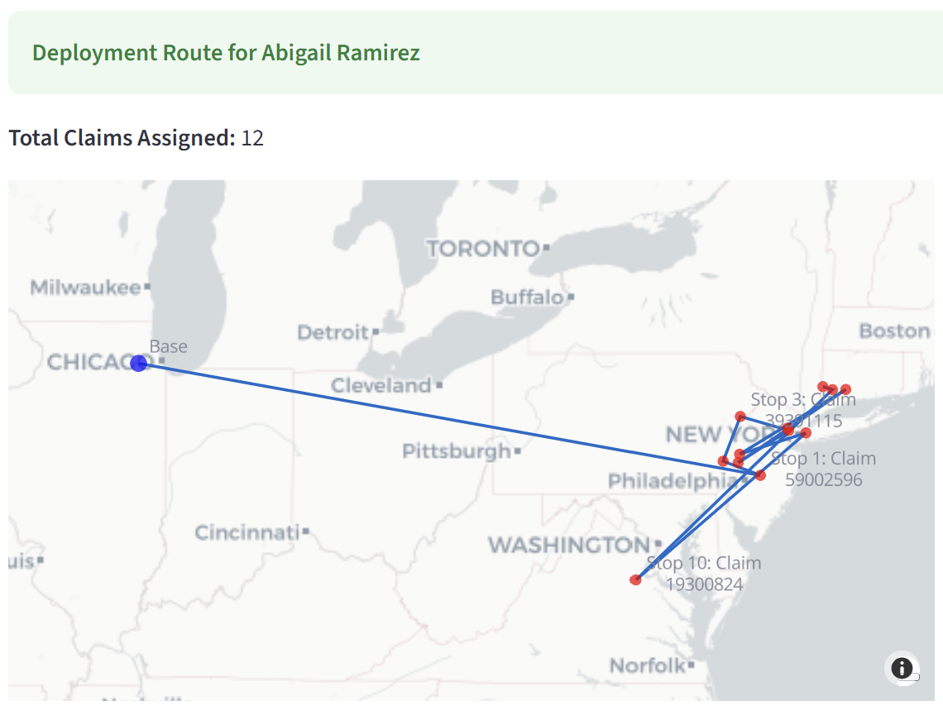
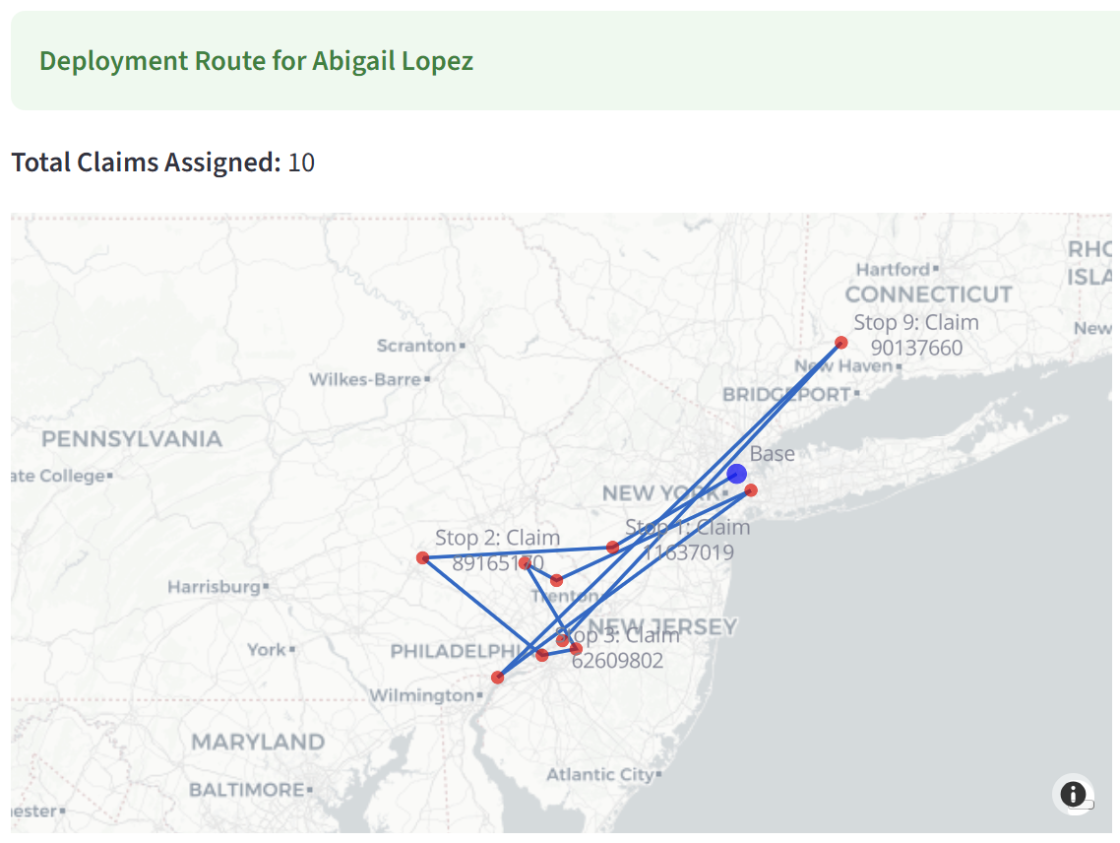
Optimized Travel Routes
Impact: Reduced Travel cost, Transit time
Flight Cost Savings:
~$43,000* saved per CAT event
~$1.04* Million saved Annually
*Calcluated for 300 adjusters across 24 similar CAT events per year
Considering avg of $850 per round trip flight
Avg Percentage of Adjusters Flying:
Typical: 55% - 65%
Our LP Model: ~43%
Fewer flights taken
Less time spent traveling
Avg % of Workday Spent Traveling:
Typical: 15% - 25%
Our LP Model: ~5% - 11%

Slide 8
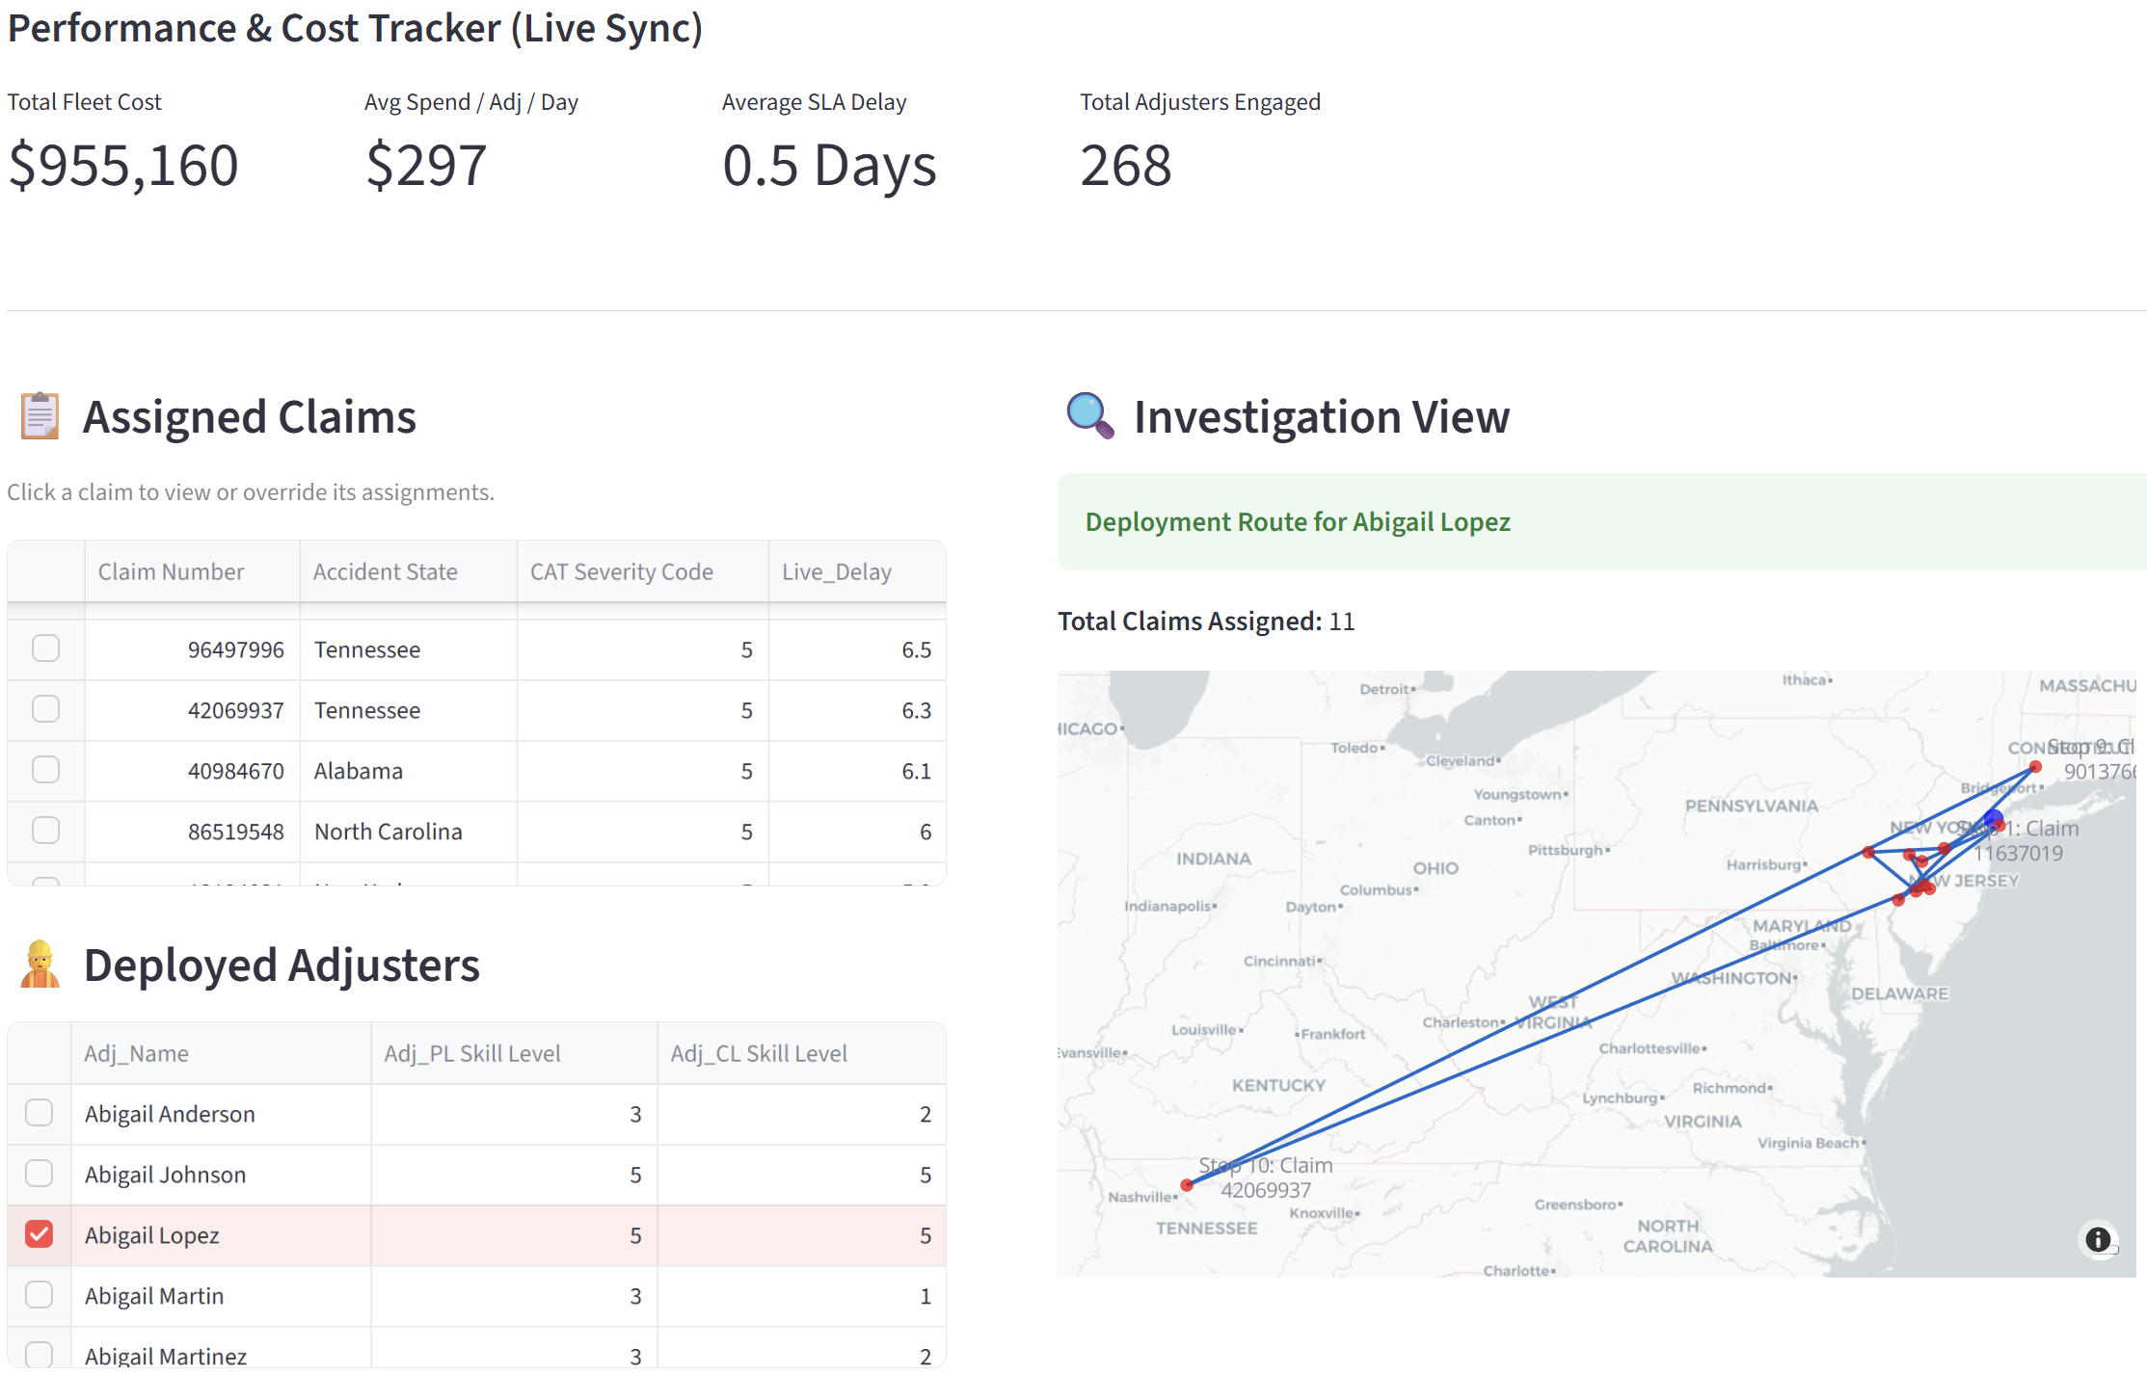
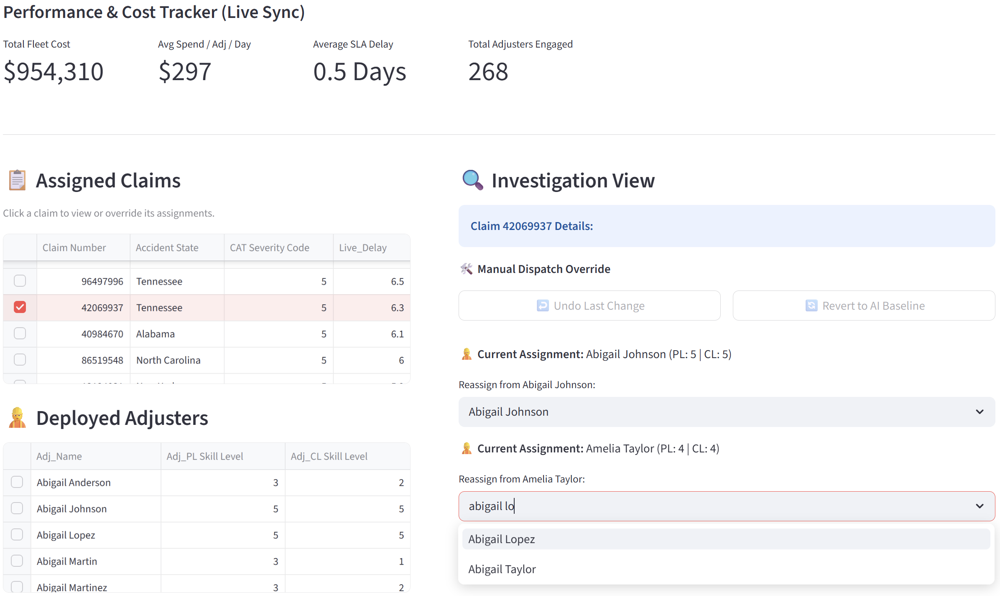
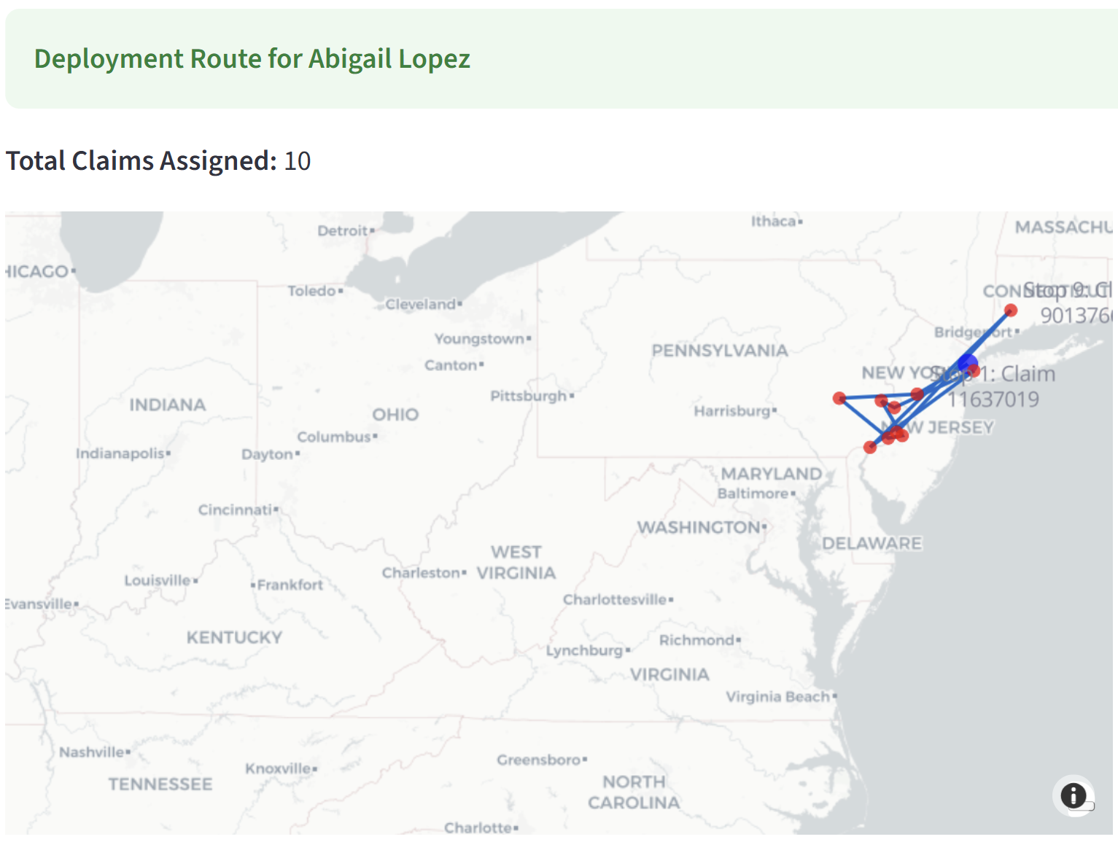

Claim Re-assignments
Deployment route before re-assignment:
Increased by $850
Total Fleet Cost before re-assignment:

Slide 9
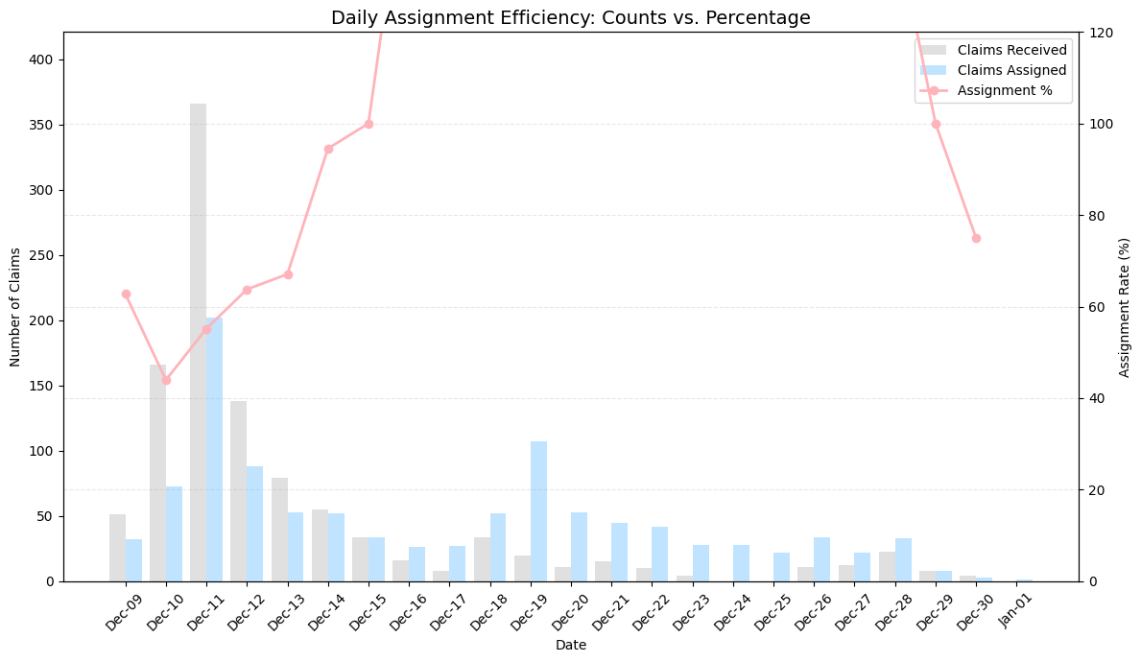
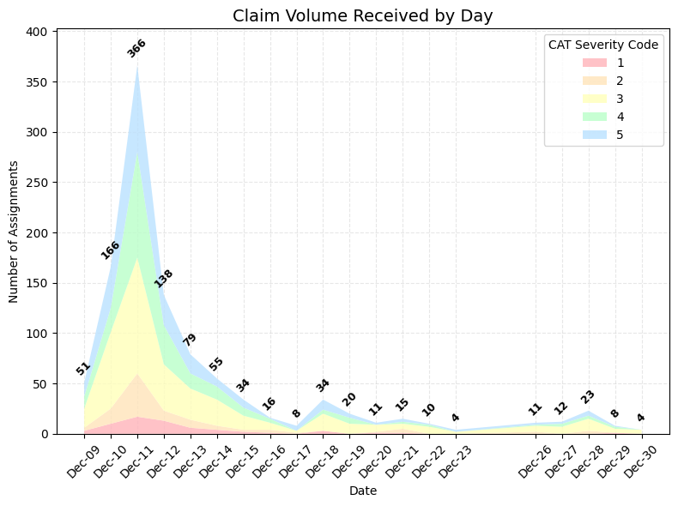
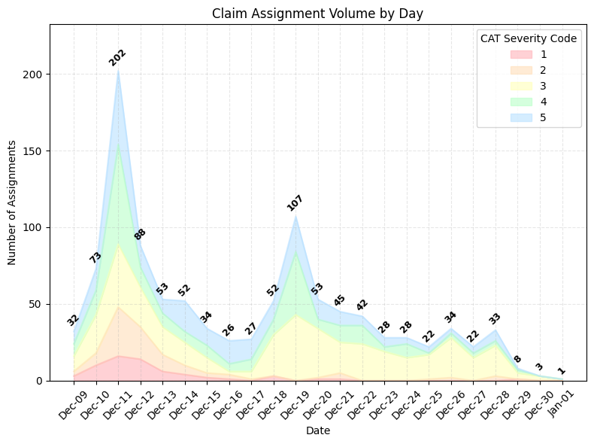
100% Claim Assignment Efficiency
Notes:
In graph number one, we can see the number of claims that we received daily during the CAT event. There is a large number of claims received specifically within the first 4 days following the event. Our model took these claims received and distributed them so that we were able to complete them all over the course of their SLA deadlines.
The second graph shows how we assigned those claims and how there were two large peaks where the majority of claim assignments occurred both in the first four days and then again around day 10.

Slide 10
Model Comparative Analysis
Model 1: Claims Model | Model 2: Adjuster Model | Model 3: Final Model
66% completed prior to deadline | 90% completed prior to deadline | 87% completed prior to deadline
8 Days Delayed | 2 Days Delayed | 1.5 Days Delayed
Notes:
Model Performance (rename the slide) - tying back to the outcome
Talk about Positive
Too much space for 1 slide
Percentage completed prior to the SLA deadline, number of days delayed, were the claims completed within 28 days

Slide 11
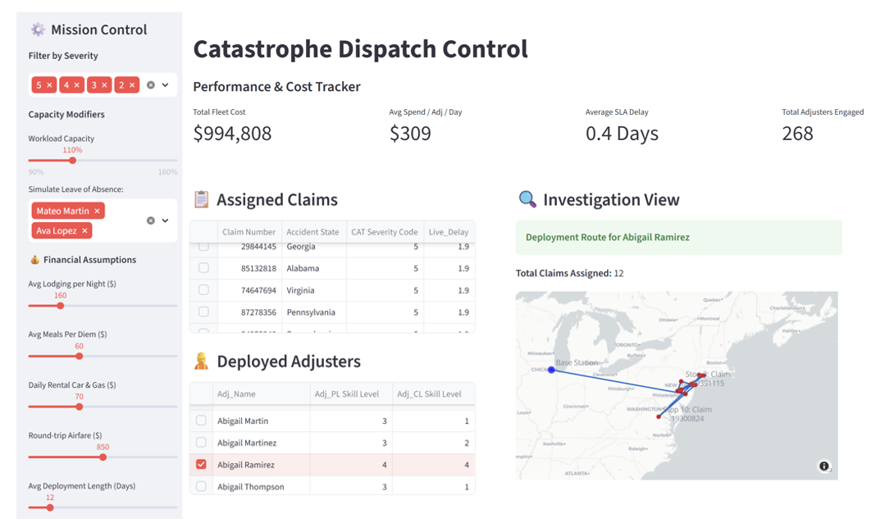
Recommendations
Improve adjuster utilization
  3rd party adjusters
  Training process
Adjuster ID
Adjuster and Claim Locations
Improve claim clarity
  Text analysis
Deployment Strategy
Claim Numbers
Delay Time
Consider additional base locations
  Proactivity
Cost Savings
Notes:
3 bullet points
Consider utilizing 3rd party adjusters
Use text analysis for claim severity assignment
Incentivize adjusters to improve skill level
Utilize skill level 3+ adjusters regardless of travel preferences
Adjusters with admin titles should train for CAT events

Slide 13
Appendix
Notes:
https://www.policygenius.com/homeowners-insurance/homeowners-insurance-statistics/#:~:text=$168%20is%20how%20much%20more%20homeowners%20pay,claim%20amount%20from%202016%20to%202020%20%5B3%5D
https://liveops.com/blog/the-hidden-costs-of-policyholder-churn-and-how-outsourcing-prevents-it/#:~:text=In%20insurance%2C%20churn%20is%20often,re%20not%20just%20losing%20premium.

Slide 14
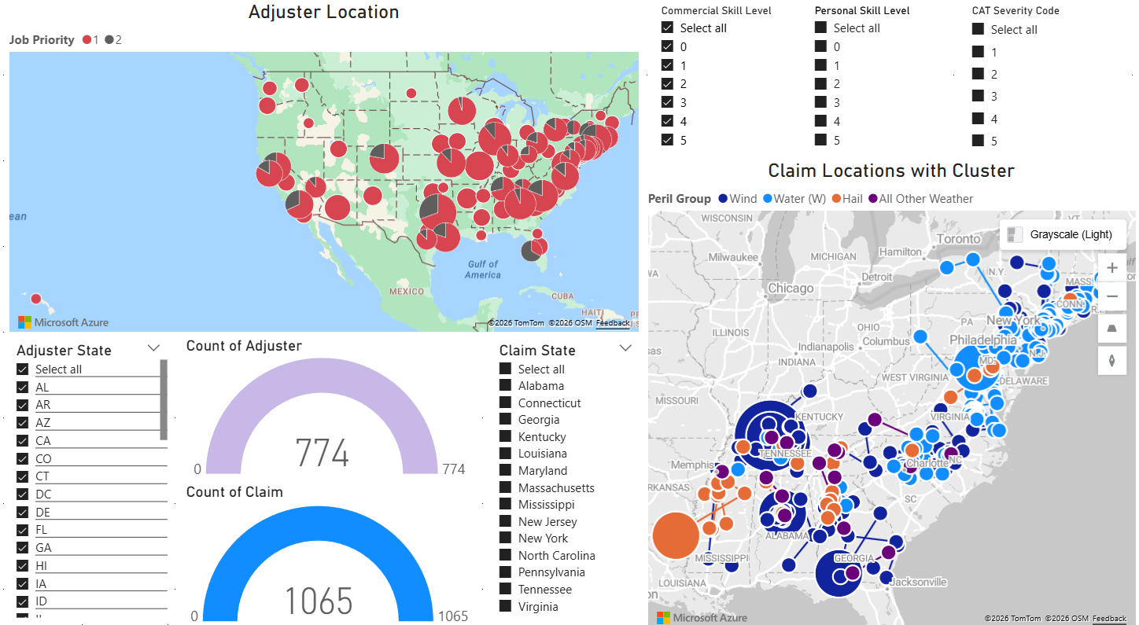
Figure 1: Claim and Adjuster Location Allocation in the U.S.

Slide 15
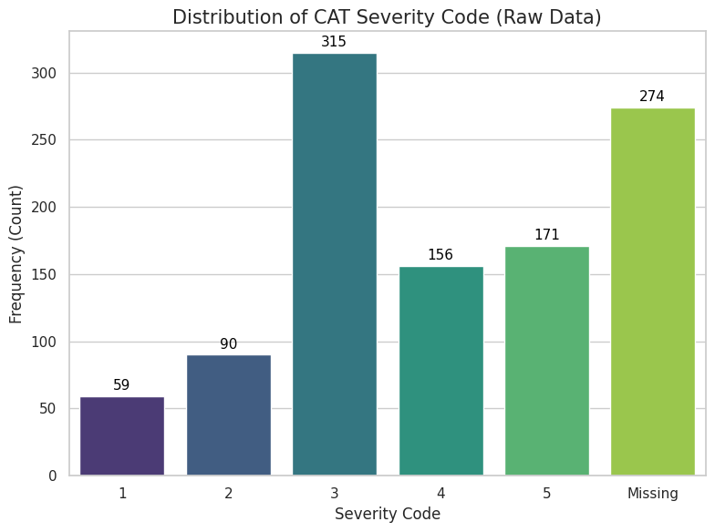
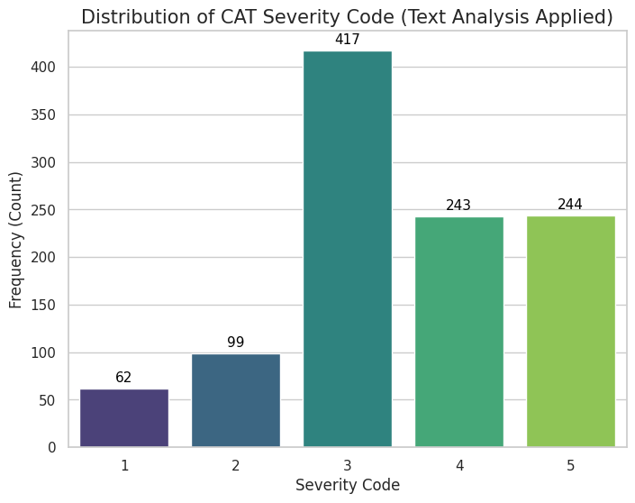
Figure 2: CAT Severity Code Distribution (Raw)
Figure 3: CAT Severity Code Distribution (Text Analysis)

Slide 16
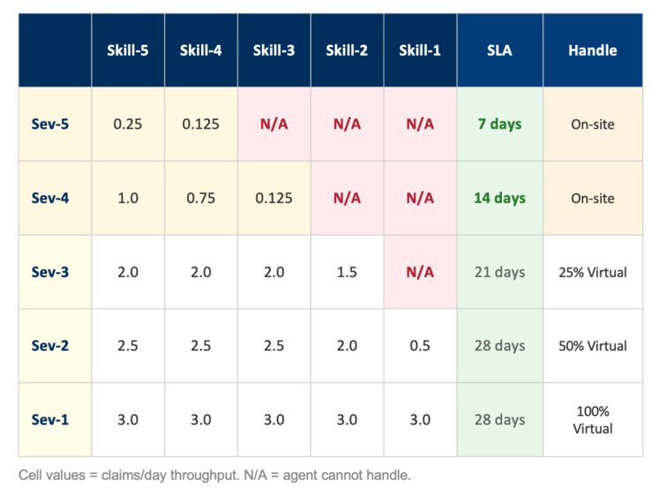
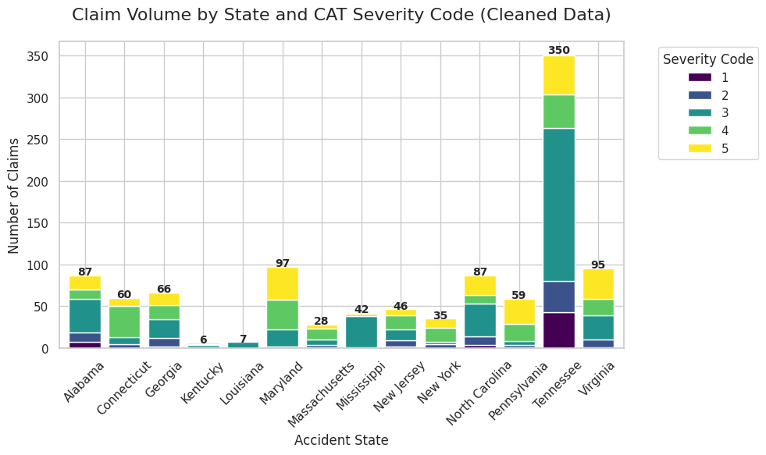
Figure 4: Service Level Agreement (Provided)
Figure 5: Claim Distribution by CAT Severity Code and State

Slide 17
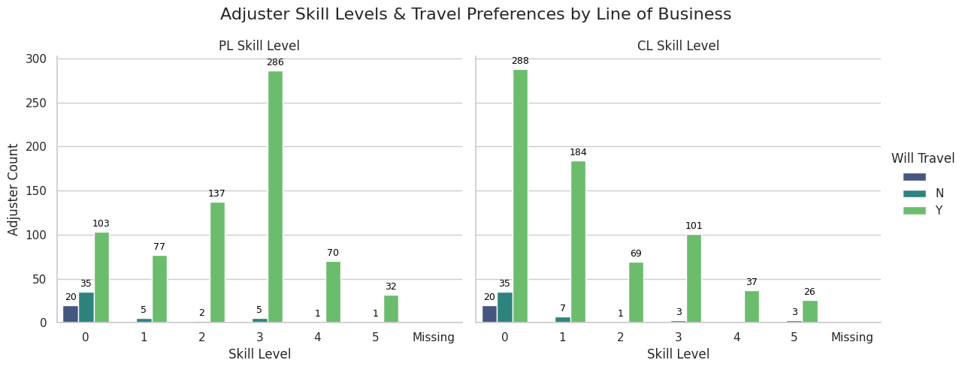
Figure 6: Adjuster Skill Levels and Travel Preferences by Line of Business

Slide 18
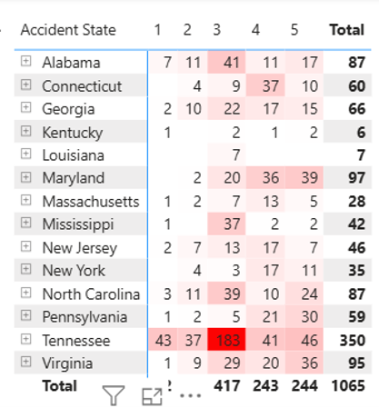
Q&A

Slide 19
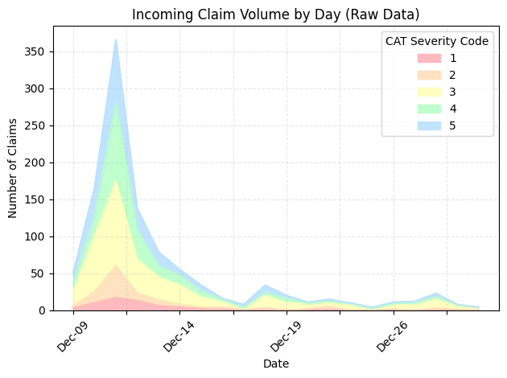
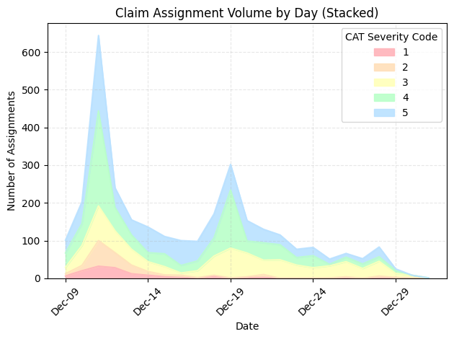
37% Claim Assignment Increase
350
650
Assignments in the first 10 days
Before Model | ~50% claims
After model | ~87% claims
87%
37% claims
300
After model
Before model
Notes:
Recap
Key Findings (2 slides total)
Rename the graphic
Explain the graphic - which metrics? By CAT? By COUNT?
How to increase productivity?

Slide 20
Results - Metrics
Cost Saving
Regulation Compliance | 100% claims solved within compliance threshold (28 days)
Customer Retention
Delayed Count | 87% CAT-5 claims solved before the deadline
Delayed Time | 1.5 days (by SLA threshold)
Notes:
Model Performance (rename the slide) - tying back to the outcome
Talk about Positive
Too much space for 1 slide

Slide 21
1. Business Problem
2. Analytical Approach
Agenda
3. Key Findings
4. Recommendations

Slide 22
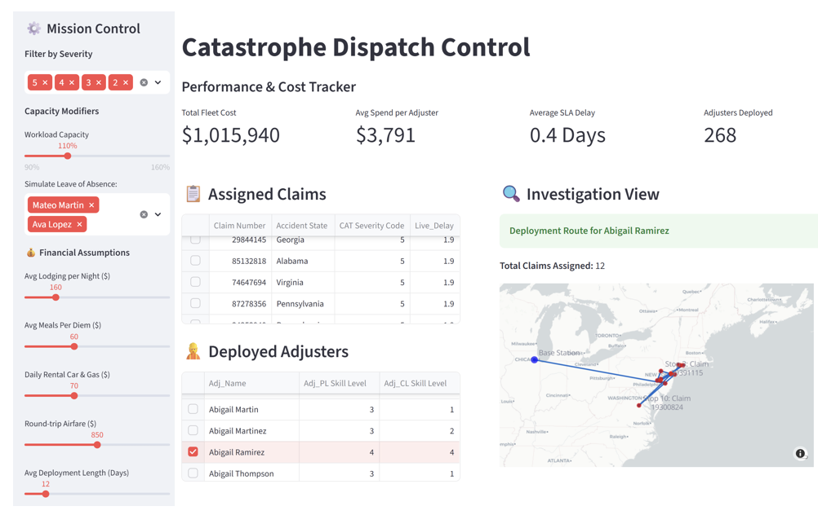
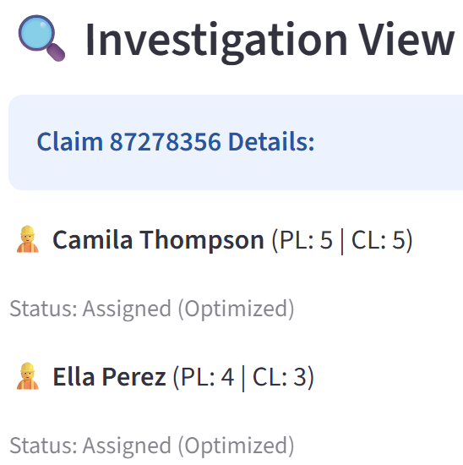

Slide 23
Web App
ST Manager
Notes:
Pop one section of web app at a time: explain each section of how the solution works. One Red animation at a time.
Have a story: create a persona who use this and how.
Explain the solution before showing the solution: dashboard operational view with metrics feeding; adjustment to features.

Slide 24
Application
Storm Trooper Manager
Notes:
Pop one section of web app at a time: explain each section of how the solution works. One Red animation at a time.
Have a story: create a persona who use this and how.
Explain the solution before showing the solution: dashboard operational view with metrics feeding; adjustment to features.

Slide 25
Objective
We built an optimization model that assigns adjusters to catastrophic (CAT) severity events cliams by proximity – leading to cost saving measures, regulation compliance, and customer retention
Notes:
We need to optimize adjuster to claim matching
1 large CAT Event
Save Costs
Needs to be usable in the future/not limited to this event only
We built an optimization model that assigns adjusters to CAT severity events based on their proximity to the event – allowing for Travelers to minimize costs, follow standard regulations and retain customers by meeting SLA deadlines.

Slide 27
Data Overview
1000+
700+
904
83
Notes:
Ratio Adjuster/Claim: 1:10

Slide 28
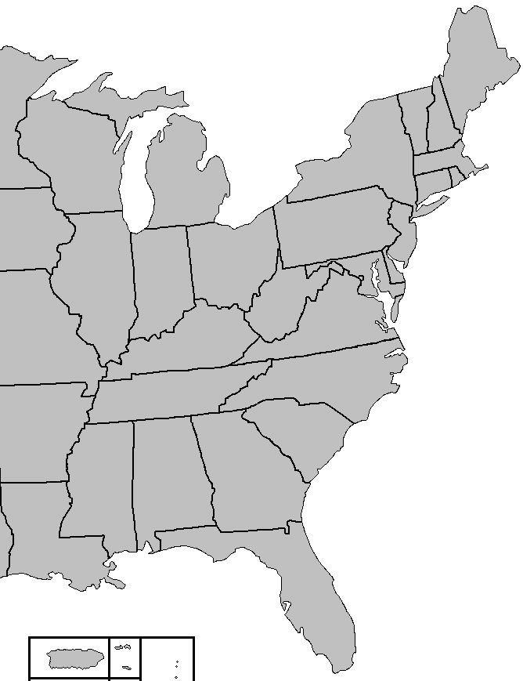
EDA
High-level adjuster shortages
Notes:
Our team decided that the model we build should match adjusters to clusters, prioritizing the clusters with the most severe severity cases and moving inwards so that we can utilize all the adjusters in one place. We determined this could be a good cost saving measure as well, because it will cut down on costs associated with distance and would cut down on the number of delays that could potentially occur ensuring that we meet SLA deadlines and keep customers.
Cluster decision & Animation

Slide 29
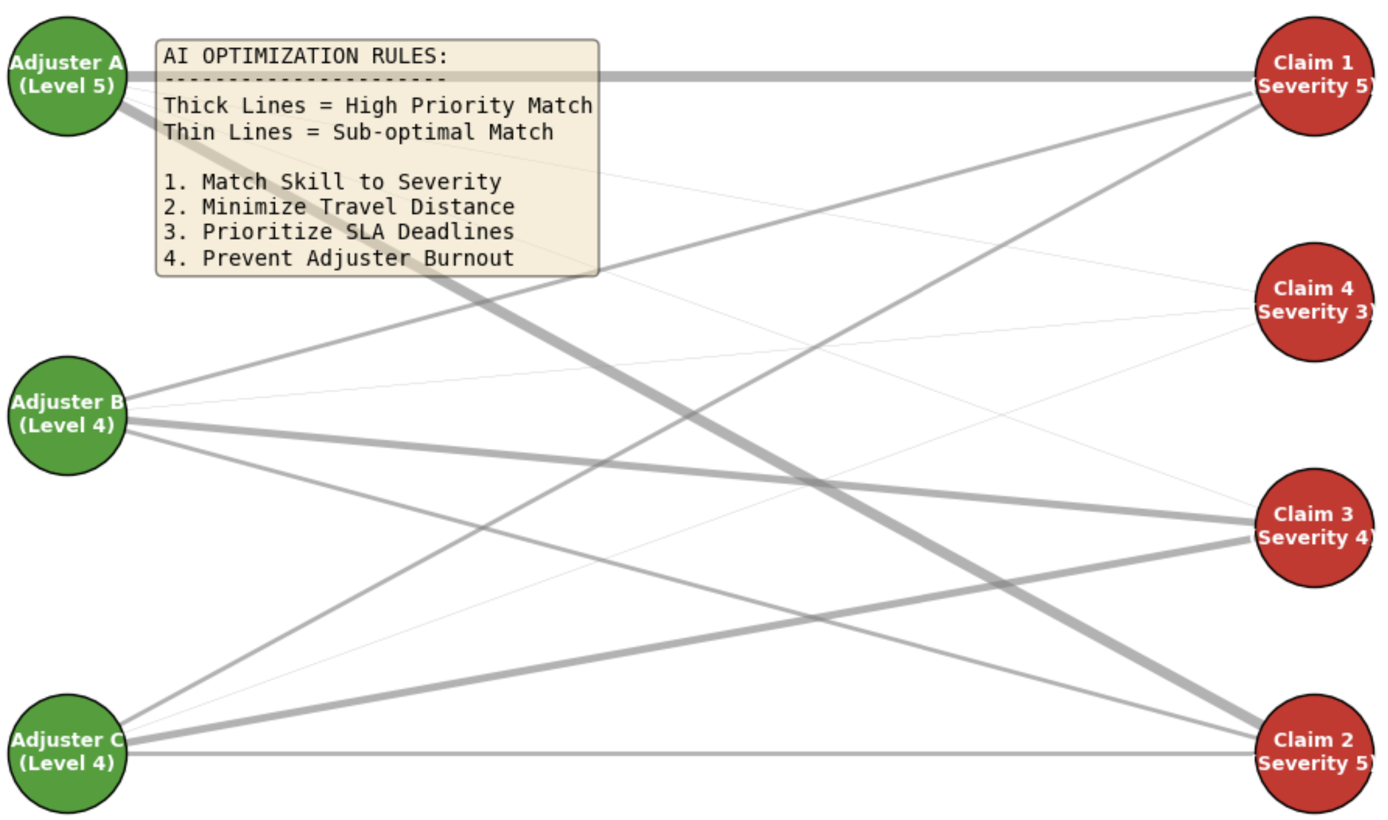
Assumptions
Skill-based match
Travel Distance Minimization
SLA Deadline Prioritization
Employee Retention

Slide 30
Model Results
Regulation Compliance | 100% claims solved within compliance threshold (28 days)
Delayed Count | 87% CAT-5 claims solved before the deadline
Delayed Time | 1.5 days (by SLA threshold)
Notes:
Model Performance (rename the slide) - tying back to the outcome
Talk about Positive
Too much space for 1 slide

Slide 31
Findings and Recommendations

